Slide 1

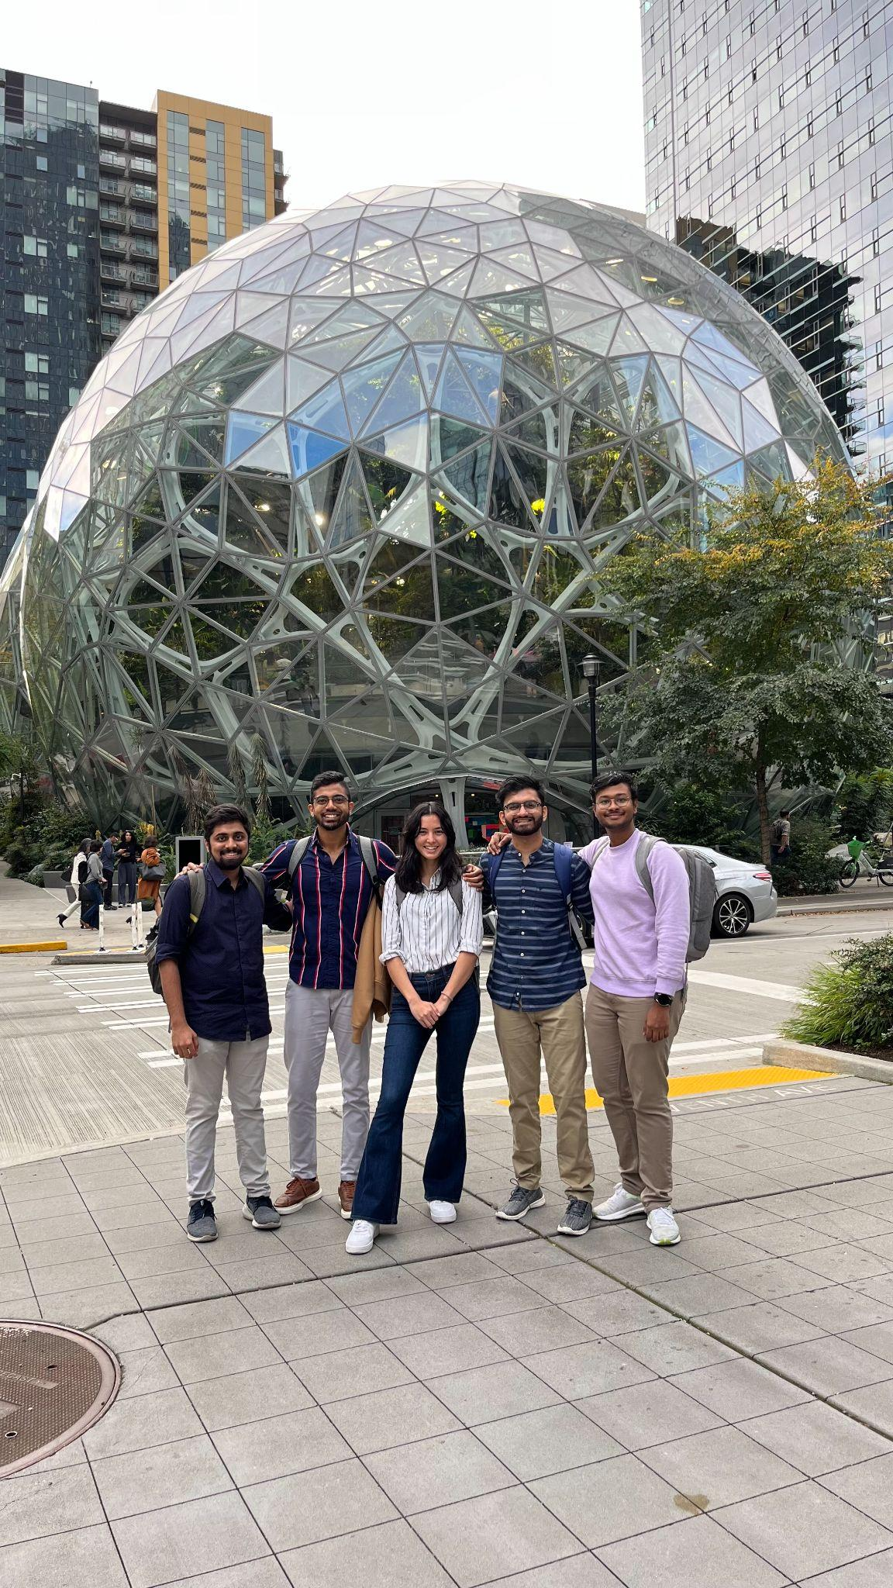
Synthetic Data Generation for S3 traffic data using Generative Models
S-Cubed
Team S-cubed

Slide 2



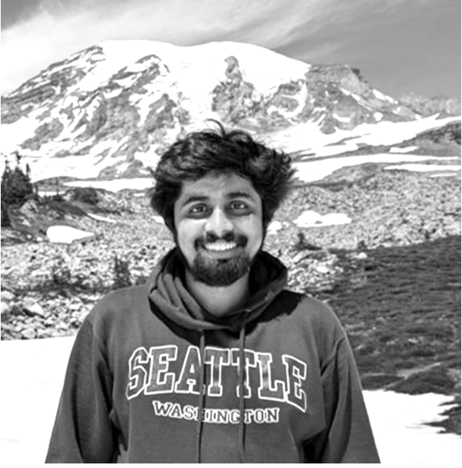


TEAM
Aditi Kharkwal
Ameya Bhamare
Neel Shah
Soham Butala
Aaditya Parthasarathy
Facilitator & Researcher
Architect & Researcher
Data Scientist & Researcher
Data Engineer & Researcher
Data Scientist & Researcher

Slide 3

Introduction
As AWS evaluates new hard drives for S3, synthetic data is key for accurately predicting future traffic patterns. Traditional testing methods often struggle to capture the complexity of future hard drive traffic patterns. Synthetic data offers a solution by approximating these patterns, a comprehensive evaluation for new hard drives' performance.
Problem Statement:
Synthetic Data Generation based on:
Realism: mirrors the complex patterns of actual S3 traffic
Historical Data Constraints: utilizing parameters like time range, disk volume, container groupings, etc
Generative Model Application: Successfully applying generative models like GANs to produce realistic, synthetic S3 traffic data

Slide 4
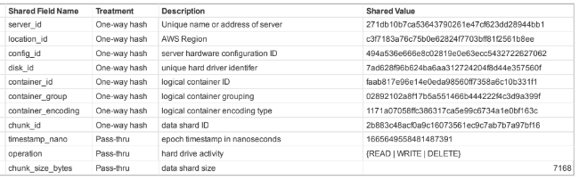
Data Profile and Summary
Data Description: S3 Hard Drive Transactions Data Records: 271 million + Type: Parquet files
Data Summary: The data is time series transactional data for Memory Traffic of S3 bucket captured every for request made across time.
12 columns
1 Timestamp variable
10 Categorical variables (IDs)
1 numerical variable (Memory size)
Conditional Sampling:
Number of Containers
Container Type
Disk Size (in TB)
Time/ Days of transaction

Slide 5

Proposed Solution
Research Generative Deep Learning and Statistical Models to generate synthetic data including conditional sampling for transactional time series data using literature review and existing projects in the same field.

Slide 6
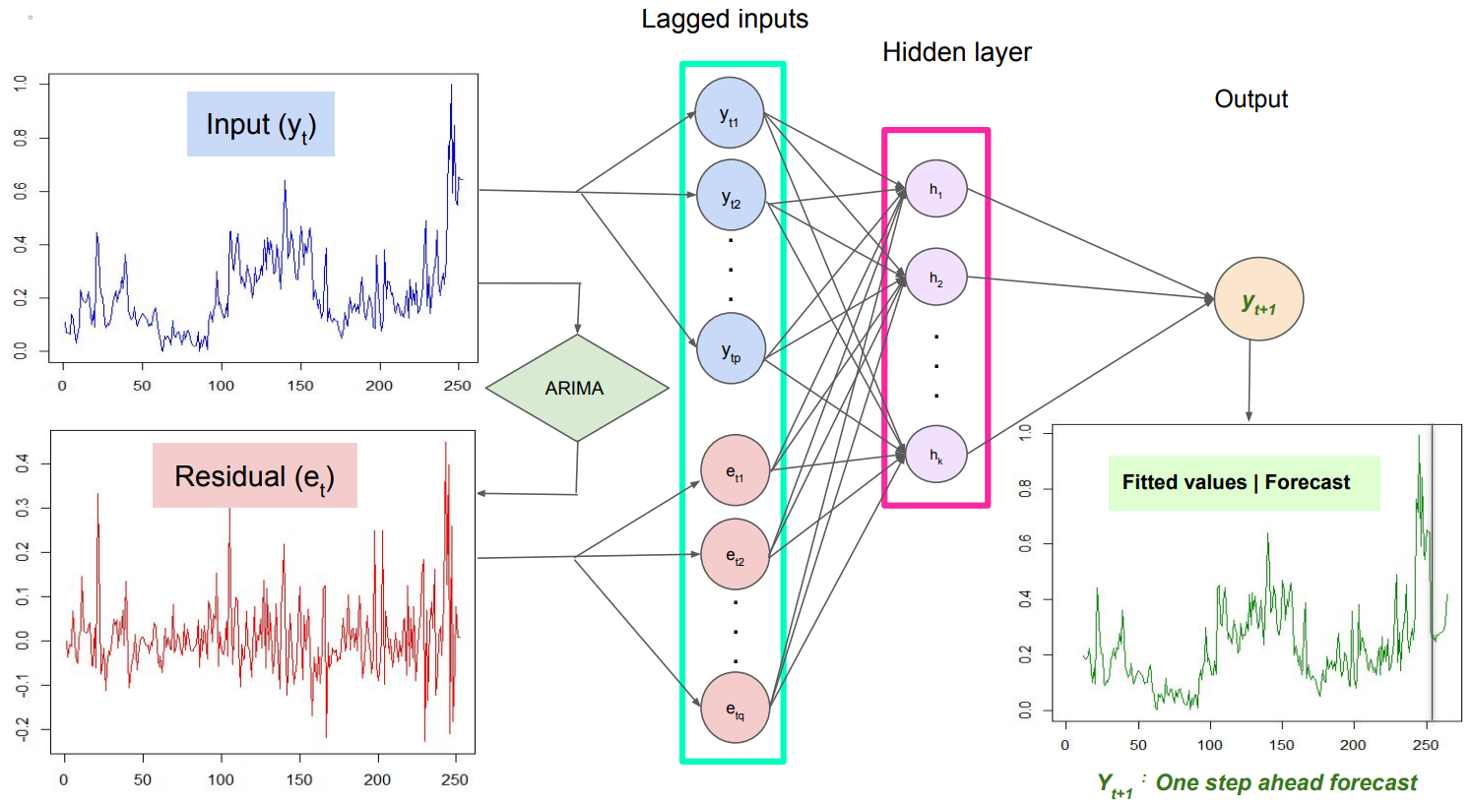

1 - PAR
Overview:
Probabilistic AutoRegressive model
Allows learning for multi-type, multivariate time series data to generate new synthetic data that has the same format and properties as the learned one.
Ability to generate new synthetic time series conditioned on the properties of the entity to which this time series data would be associated
Our Experience:
PAR needs a feature dependant on time series to predict for the future and entity variable.
Model Generated negative data for time dependant target variable and failed for our use case.

Slide 7
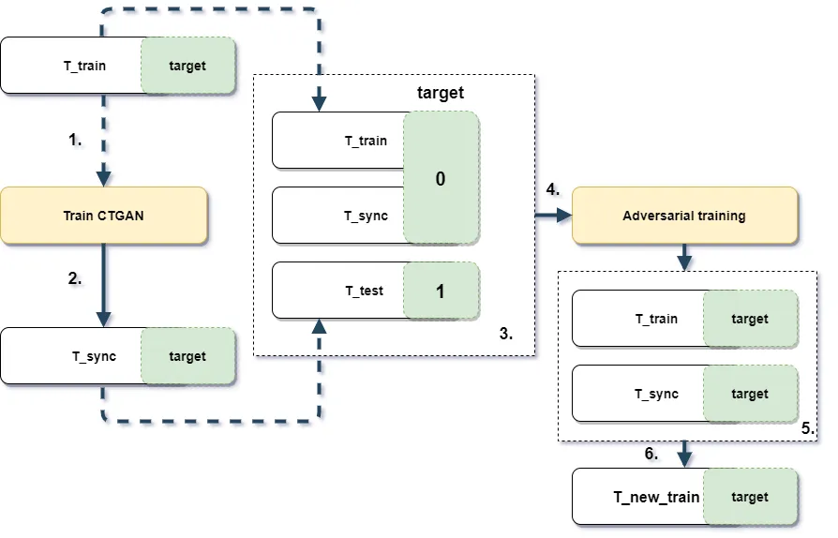
2 - TABGAN
Overview:
Extension of CTGAN, specialized for tabular data.
Excels in scenarios with distinct target values.
Our Experience:
Model Generated negative data for target variable with sparse data.
No option to pass conditions while generating synthetic data.
Future Scope:
Introduction of ForestDiffusion makes this model an avenue for future exploration.
Notes:
Developed to address the unique challenges associated with tabular datasets, such as handling mixed data types and imbalanced data.
One hot encoding - Categorical
Bayesian Gaussian Mixture - Continuous
Use case - when you need more data than you have (for example, for training machine learning models) or when you want to keep your original data private but still need realistic data for analysis or development purposes.
Bank Transactions - Insaf Ashprov
Data has complex relationships and cannot be modeled into train and target form
Synthesizer needs to be updated altogether to pass conditions while generating the synthetic data
Forest Diffusion vs Generator Discriminator model

Slide 8
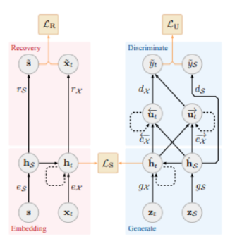
3 - TimeGAN
Leverages a combination of supervised and unsupervised learning.
Employs four key components:
Embedding function
Recovery function
Sequence generator
Sequence discriminator
Difficult while training with Categorical features.
Our Experience:
TimeGANs do not support categorical features
Conversion with One-hot encodings leads to problems like the loss of information between multiple features and increased dimensionality.

Slide 9
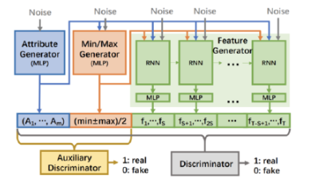
4 - DoppelGANger
Standard GANs struggle with time series' characteristics, like long-term dependencies and complex relationships between data points.
DoppelGANger addresses this by incorporating a custom workflow that focuses on capturing the data's structural properties, including long-term patterns.
Our experience:
Again, working with categorical features includes one hot encoding by default in the model. This leads to,
Increases in dimensionality of the model.
loss of relationships between categorical variables.
Not optimised for implementation of conditional generation of data based on external variables.

Slide 10
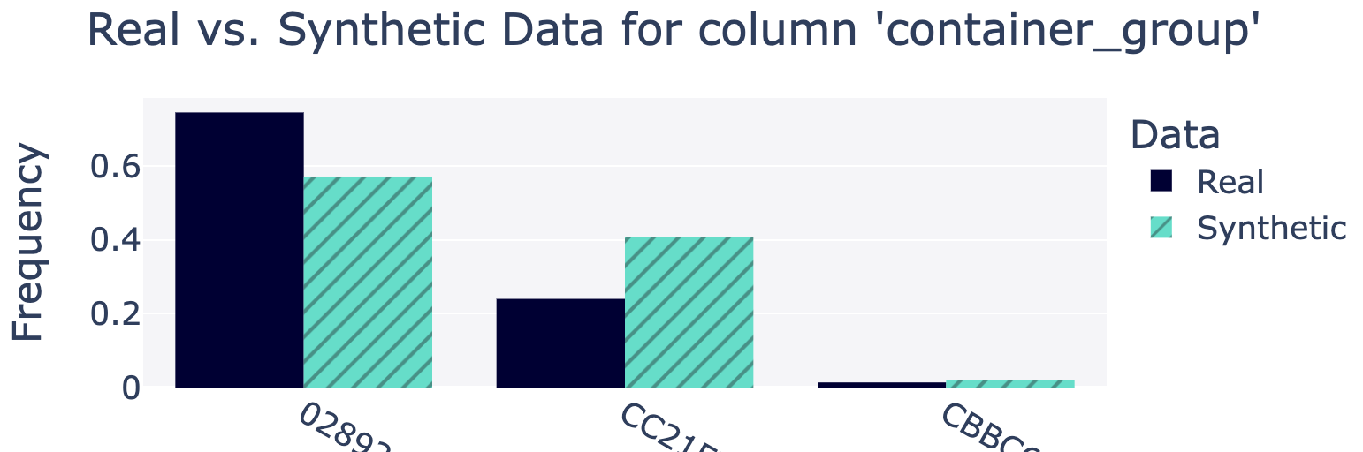
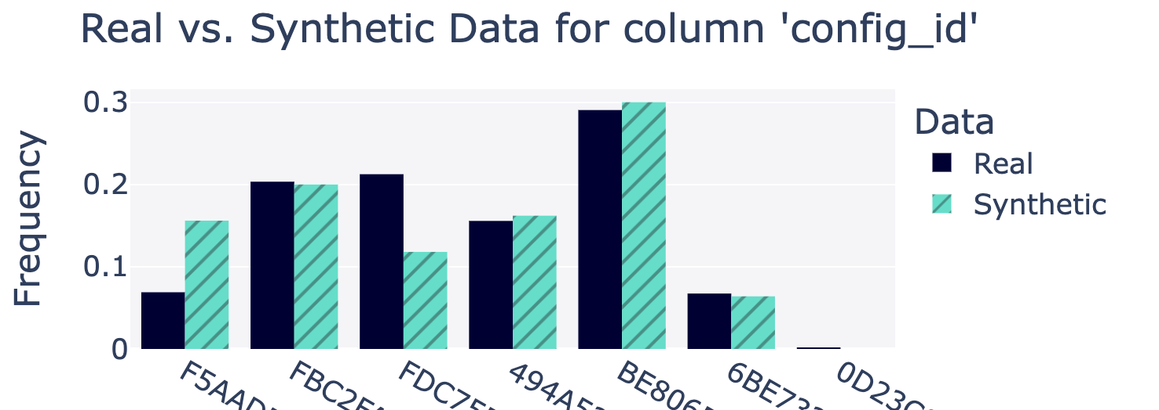
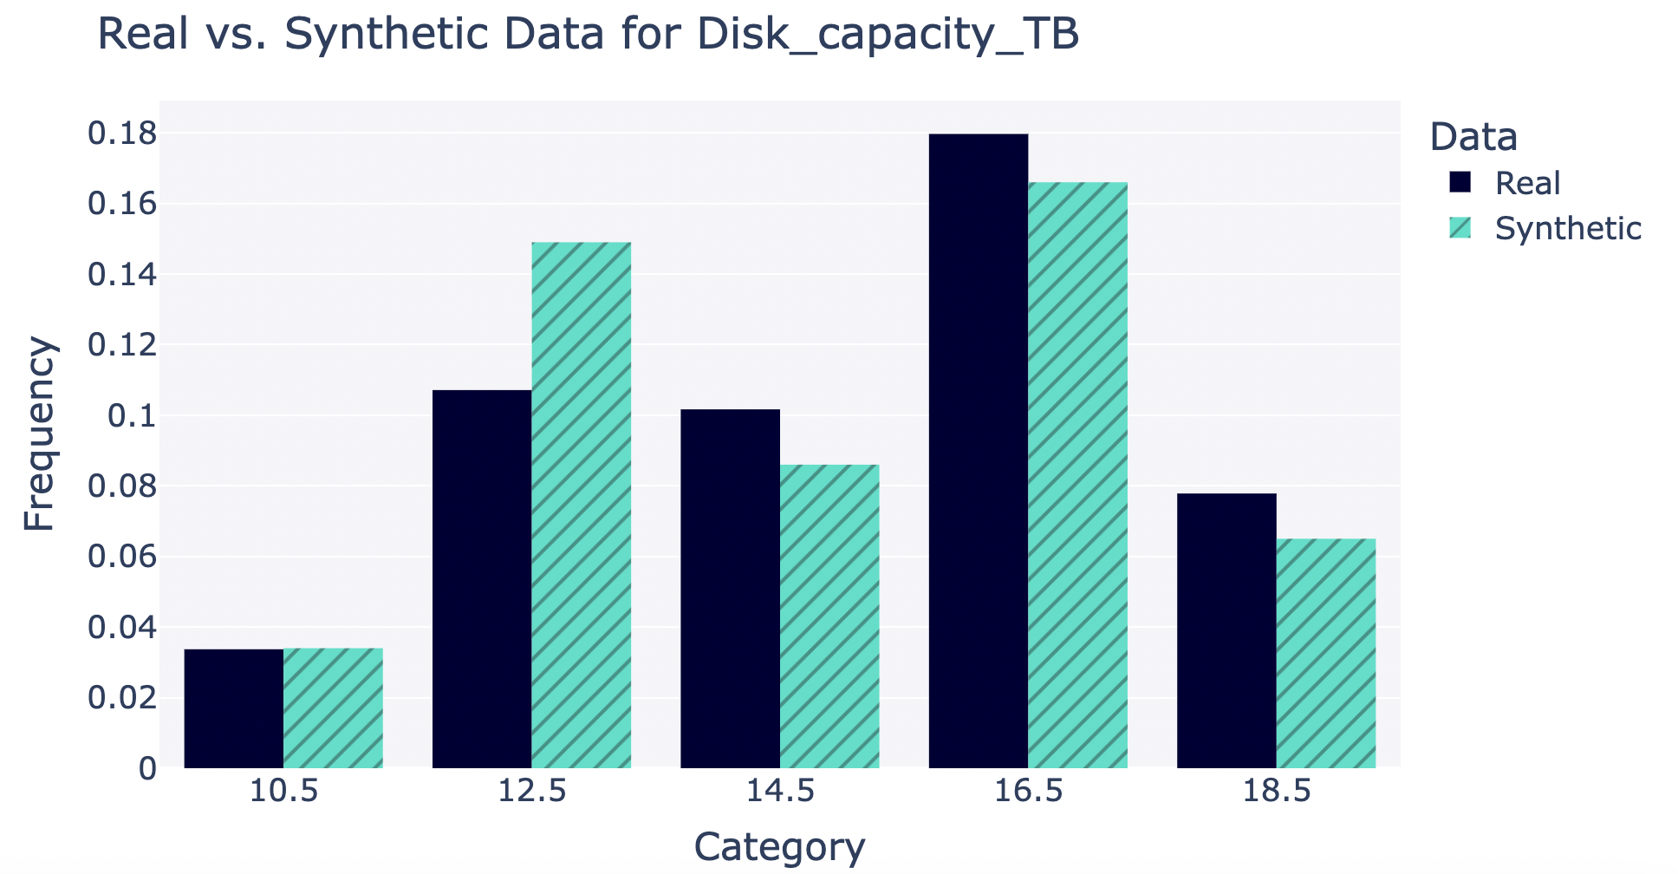
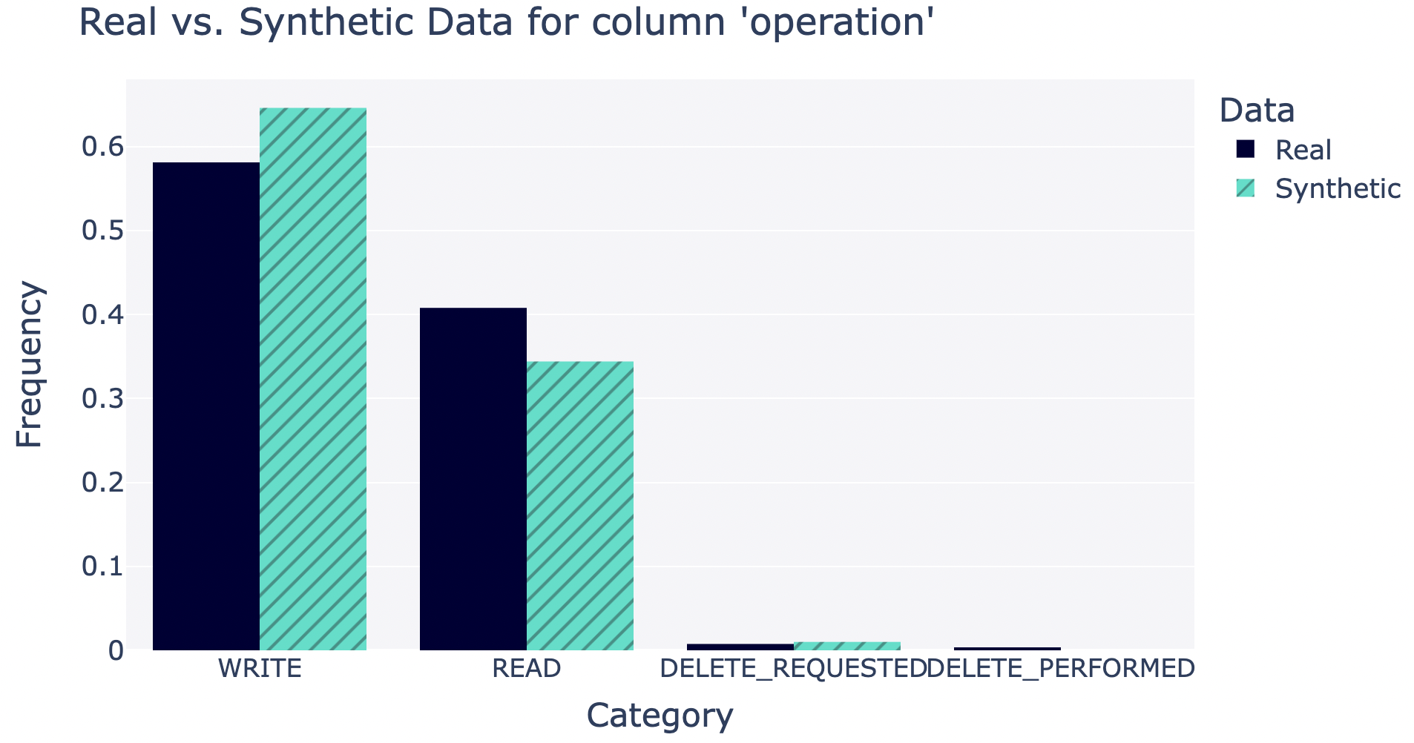
5 - CT GAN
Best working Generative model for our problem statement. Developed to address the challenges of generating synthetic data that preserves the statistical properties and relationships found in the original dataset.
Key Features:
Conditional generation
Mode collapse mitigation
Flexibility
Training:
Data: After cleaning 15k rows
Training time: 212 minutes
Loss: Gen. (1.62) | Discrim. (-0.10)
Evaluation Metrics and Results:
Fidelity: For each column values fidelity was evaluated
Data Quality score = 0.69
Shortcomings:
High Compute Power
Long training time due to complexity of GAN architecture.
Notes:
Need to look into the throughput of data

Slide 11
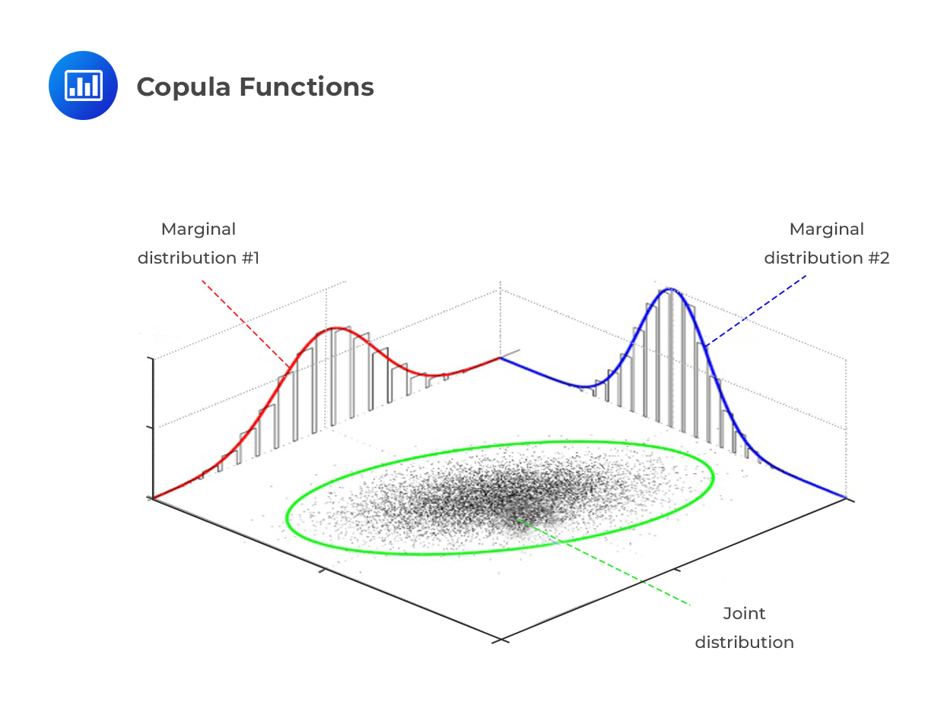
6 - Gaussian Copula (Final Model)
A Gaussian copula maps the marginal distribution of each variable to the standard normal distribution.
Steps
All variables standardized - unit variance and zero mean
Correlation matrix computed - quantifies linear relationship between pairs of variables
Generate synthetic data with same dependence structure as the training data
Advantages
Based on well-established statistical methods - require less computational resources and training time
Works fast with high dimensional data as it primarily deals with the correlation matrix of variables
Provides a clear and interpretable framework for modeling dependence structures

Slide 12
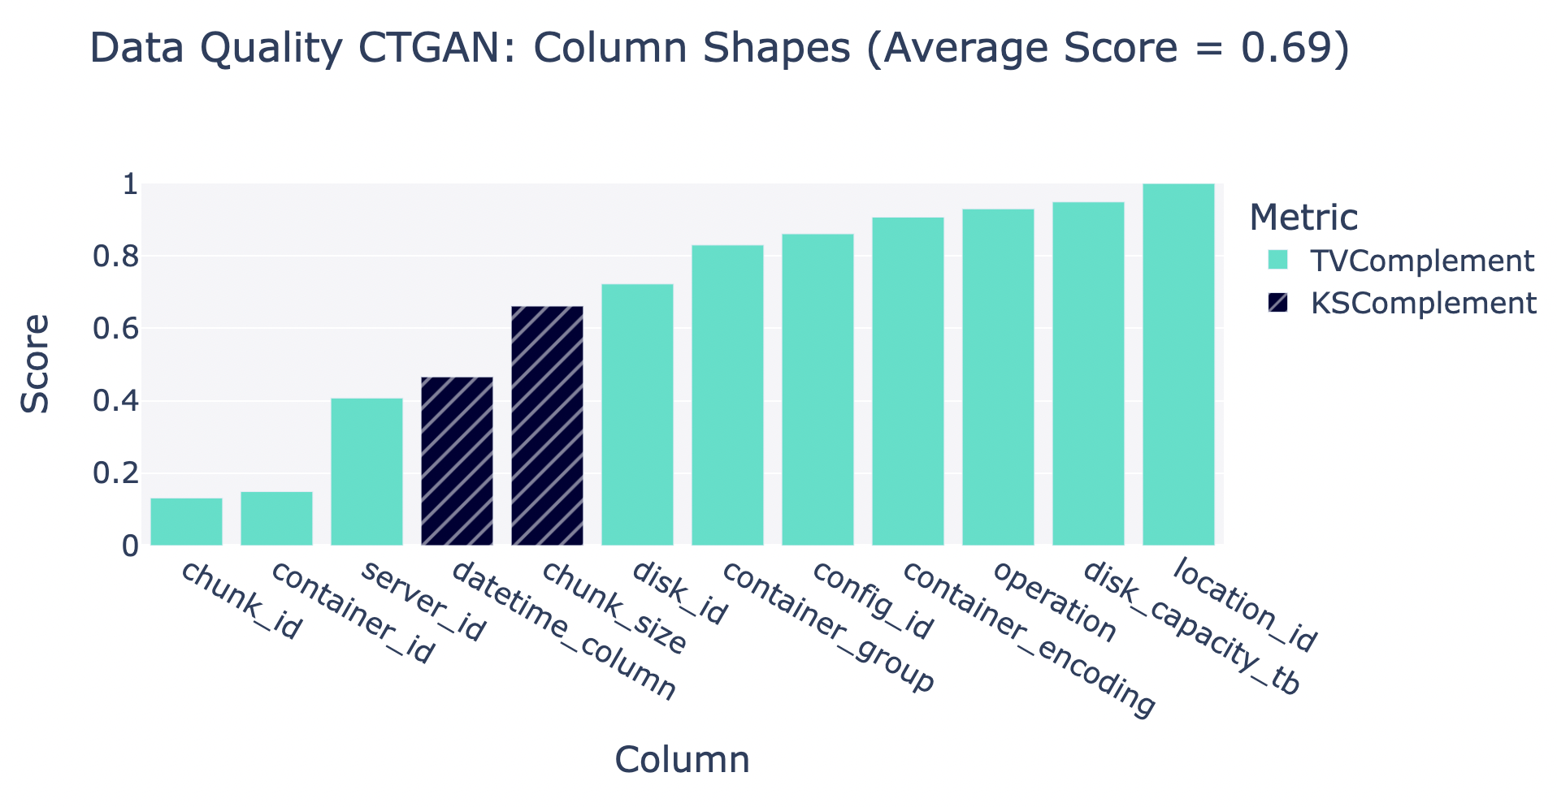
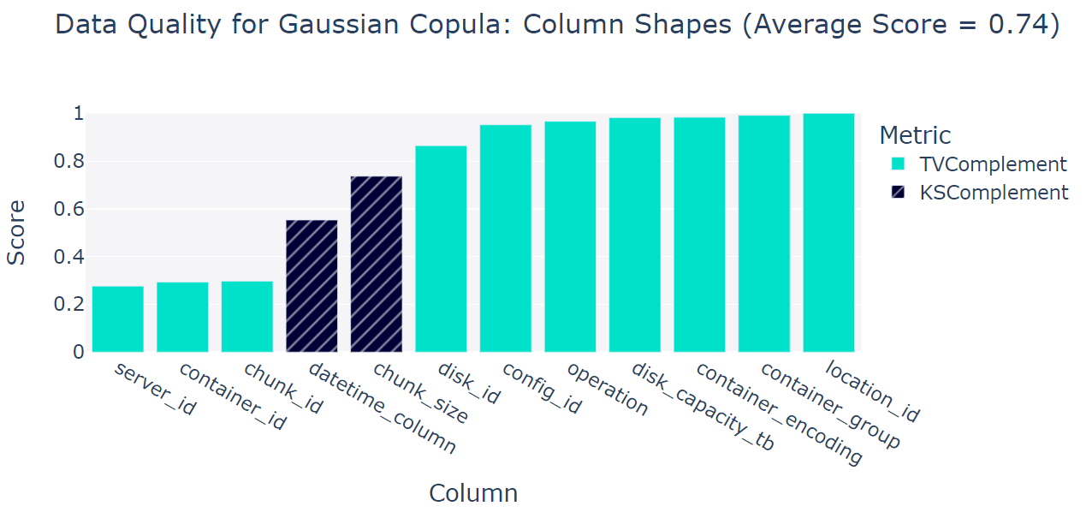
Gaussian Copula vs CTGAN

Slide 13
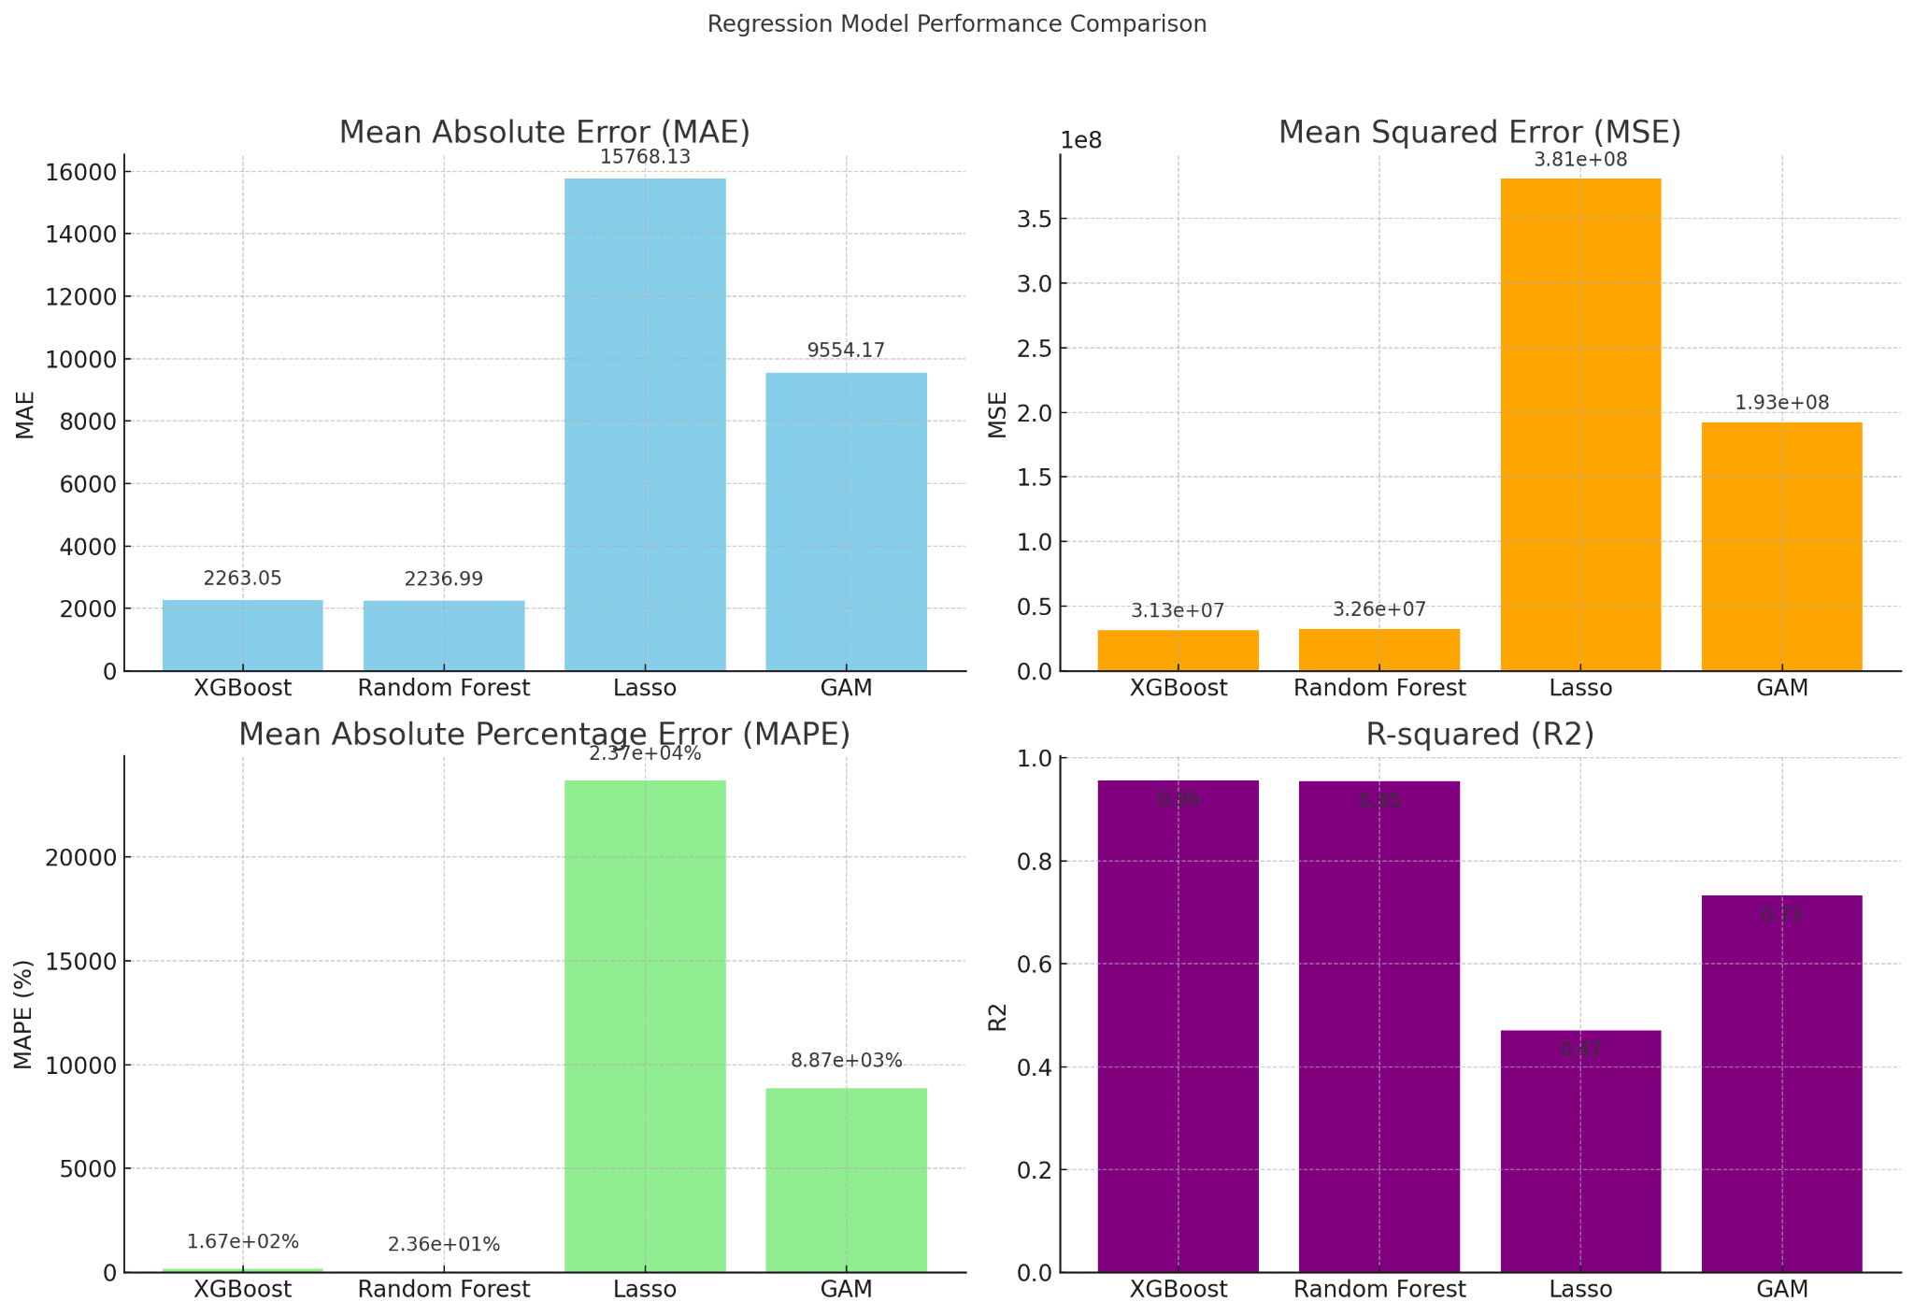
Predictive Modeling for Transaction Volume
Notes:
XGBoost and Random Forest have similar performance, with low MAE and MSE, suggesting good predictive accuracy.
Lasso's errors are considerably higher, indicating that it might not capture the data's complexity as effectively.
GAM shows better performance than Lasso but still lags behind XGBoost and Random Forest. More data and better hyper parameter tuning
We also tried Prophet model for time series analysis but the results showed that it struggled with the dataset. Prophet faced challenges with our particular dataset, which featured multiple observations per day—each tied to a unique configuration. This multi-observational structure is critical for making predictions, especially for unseen configurations. Prophet's standard approach to time series analysis, which typically expects a single observation per time interval, might not be directly applicable without modifications to accommodate the dataset's unique format.
Cyclical Encoding - Sin and Cos of day and month

Slide 14
Data Validation and Testing
Null Check
Uniqueness
Date Range Alignment
Cumulative size checks against container capacity (16 GB)
Notes:
Null Checks
Uniqueness Check - wrt to Original Data and within Synthetic data
Range Test - Operation, container groups, containers, Number of transactions and chunk size
Date Range Alignment - datetime column is within specified range
Cumulative size checks against container capacity (16 GB)

Slide 15
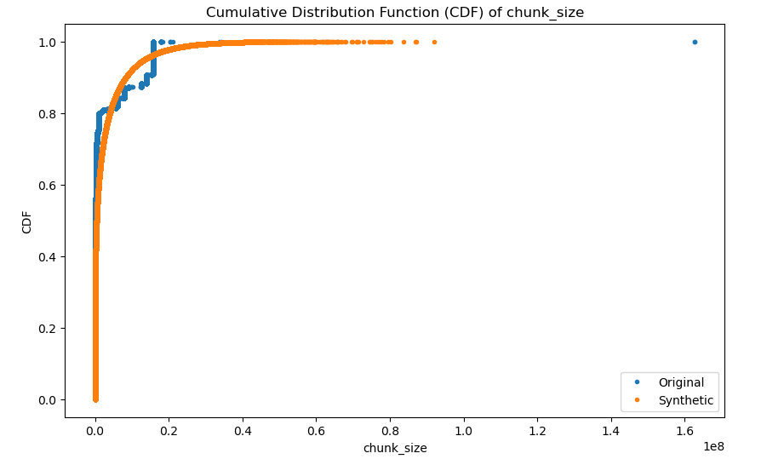
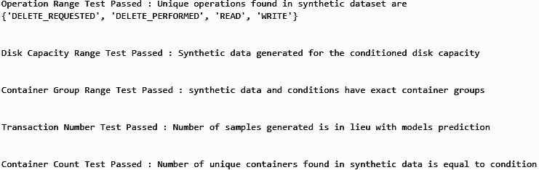
Data Validation and Testing
Distribution Consistency
Range Tests
Notes:
Range Test - Operation, disk capacity, container groups, containers, Number of transactions

Slide 16
Results | Demo
Gaussian Copula for Synthetic Data Generation
Sagemaker Notebook Demo

Slide 17
Thank You
Q&A

Slide 18
Appendix

Slide 19
References
Xu, L., Skoularidou, M., Cuesta-Infante, A., & , K. (2019). Modeling Tabular Data using Conditional GAN. In 33rdnference on Neural Information Processing Systems (NeurIPS 2019)
Ashrapov, Insaf. "Tabular GANs for uneven distribution." arXiv preprint arXiv:2010.00638 (2020).
Lin, Z., Jain, A., Wang, C., Fanti, G., & Sekar, V. (2019). Using GANs for Sharing Networked Time Series Data: Challenges, Initial Promise, and Open Questions.
Yoon, Jinsung, Daniel Jarrett, and Mihaela van der Schaar. "Time Series Generative Adversarial Networks." In Advances in Neural Information Processing Systems, vol. 32, pp. 36-48. 2019.

Slide 20
TEAM BIOS
Ameya Bhamare has spent 2+ years in E2E Data Science solutioning from start-ups to MNCs in healthcare, real, mobility, supply chain and IT. His interest lies in Applied ML, Data Analytics, Agile Product Development and Cloud ML platforms. He is the coordinator for this project.
Aditi Kharkwal has spent 3 years working as a BI Developer and Data Analyst. She has worked at Wolters Kluwer and Micron. Her interest lies in Deep Learning, Computer Vision, Statistical Modelling and Applied ML. She is currently fine tuning VLMs for robotic manipulation tasks.
Neel Shah has 3.5 years of work experience as Data Scientist at Mu Sigma and has worked in business domains like Healthcare, Finance, EV etc. He is interested in ML, AI, LLMs, NLP, RWE and has worked with fortune 500 clients to optimize business decisions and improvise marketing strategies.
Soham Butala has 3.5 years of experience as an Analyst at Deloitte and Majesco. He is the architect behind the open-source project Echoflow and is presently focused on vector databases, with a keen interest in Time Series, ML, AI, Database Optimizations, and Cybersecurity.
Aaditya Parthasarathy has spent 3+ years in ML and SWE development, spanning disability-centric apps, wake word detection, and neuroscience research. He's keen on optimization, visualizations and statistical machine learning. He's currently a Data Science Intern at Amtrak, focusing on server utilization.
S-cubed @ Amazon HQ

Slide 21

Literature Review
Vector Quantized Time Series Generation with a Bidirectional Prior Model - Uses vector quantization (VQ) techniques to address the Time Series Generation problems which typically utilize GAN combined with RNN variants.
The best Generative AI Model for Time-Series Synthetic Data Generation - Exploring TimeGAN and YData Fabric for Synthetic Data Generation of Temporal Patterns
WC-GAN - Generating synthetic transactional profiles to preserve data utility and privacy.
Survey on Synthetic Data Generation, Evaluation Methods and GANs - Explores several variants of GANs that are used for micro data generation both text and images.
Generating Faithful Synthetic Data with Large Language Models - A study on three strategies to increase the faithfulness of synthetic data: grounding, filtering, and taxonomy based generation.

Slide 22
Schedule
 | Sprint 1 (December 20) | Sprint 2 (January 15) | Sprint 3 (January 30) | Sprint 4 (February 14) | Sprint 5 (February 29) | Sprint 6 (March 15)
Infrastructure Setup
Data Processing
Proposed Model 1
Proposed Model 2
Proposed Model 3
Proposed Model 4
Proposed Model 5
Hyper-parameter tuning
Validation and Performance Benchmarking
Documentation and Poster Presentation

